Slide 1

Recognizing Nutrient Deficiency in Paddy Crop using Neural Networks
by
K. J. Bharath Kumar
Roll No. 204G1A0520
N. Hari Krishna
Roll No. 214G5A0505
P. Nandini
Roll No. 204G1A0564
M. Gnapika Bai
Roll No. 204G1A0533
Under the guidance of
Mr. P. Veera Prakash M.Tech, (Ph.D), MIEI, MCSI
Assistant Professor & HOD
Department of Computer Science and Engineering
Srinivasa Ramanujan Institute of Technology
(Autonomus)
2023 - 2024

Slide 2

Contents
Abstract
Introduction
Proposed System
Planning
Design
Implementation
Conclusion
Research Paper
References

Slide 3
Abstract
In the economic landscape of India, agriculture stands as a pivotal sector encompassing both plant cultivation for food production and the management of domesticated animals. Nutrient management forms a cornerstone of agricultural practices, profoundly influencing crop growth and productivity. Just as with other crops, pests, illnesses, and dietary deficits can affect rice, necessitating continuous advancements in agricultural techniques to bolster output.
In this context, a notable transformation has swept through agriculture, aiming to amplify yields. Focusing on rice, a vital food source, this study captures images of paddy plant leaves, subsequently subjecting them to MobileNetV2 algorithm, a Convolutional Neural Network (CNN) processing. By employing image processing methodologies, a model is constructed to identify various deficiencies present in the leaves. Notably, the proposed approach leverages color and textural characteristics to effectively detect and categorize inadequacies. The integration of CNN technology offers a potent avenue for promptly identifying nutrient insufficiencies within leaves. This proactive identification equips farmers with the information needed to undertake timely corrective measures. Ultimately, this research contributes to the evolution of agriculture by facilitating the detection and rectification of nutrient-related challenges, thereby fostering improved crop health and overall agricultural productivity.
Keywords: Convolutional Neural Network, Bolster, Fostering, Colour and Texture, MobileNetV2, Nutrition Deficiency.

Slide 4
Introduction
Agriculture, as the backbone of our economy, faces persistent challenges, and among them, nutrient deficiency in paddy crops remains a critical concern impacting global food security. In an era where technological advancements are reshaping industries, this project introduces a pioneering solution for early detection of nutrient deficiencies in paddy crops using neural networks.
Traditional methods of nutrient assessment often fall short in terms of accuracy and timeliness, hindering farmers from implementing timely corrective measures. Leveraging the power of convolutional neural networks (CNNs), this project aims to revolutionize the way we monitor crop health. The neural network will be trained on a diverse dataset of paddy crop images, allowing it to learn intricate patterns associated with various nutrient deficiencies.
By providing a real-time, non-invasive, and accurate means of identifying nutrient deficiencies, the project aligns with the principles of precision agriculture. The user-friendly interface ensures accessibility for farmers, empowering them with actionable insights. The scalability and adaptability of the solution are designed to cater to diverse agricultural landscapes, contributing to the global effort to enhance agricultural productivity sustainably. This project serves as a bridge between technology and agriculture, promising to transform crop management practices and contribute to a more food-secure future.

Slide 5
Problem Statement
Nutrient deficiency in paddy crops is a persistent challenge in agriculture, leading to reduced crop yield and compromised quality.
Identifying these deficiencies early is crucial for implementing corrective measures and ensuring optimal crop health.
Traditional methods of nutrient assessment are often time-consuming and may not provide real-time insights, hampering the ability of farmers to address issues promptly. Therefore, there is a pressing need for an efficient and non-invasive solution to detect nutrient deficiencies in paddy crops

Slide 6
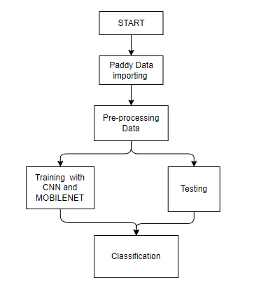
Proposed System
The proposed system aims to revolutionize nutrient deficiency detection in paddy crops by introducing an innovative approach leveraging neural networks, specifically convolutional neural networks (CNNs).
The system involves the analysis of images captured from paddy fields, enabling the automatic identification of subtle signs indicative of nutrient deficiencies. The neural network is trained on a diverse dataset, allowing it to learn complex patterns associated with various nutrient deficiencies.
The user-friendly interface facilitates seamless interaction, allowing farmers to upload images and receive instant reports on their crops' nutritional status. Unlike the existing system, the proposed approach offers a non-invasive, real-time, and accurate solution to nutrient deficiency monitoring.
Architecture of Proposed System :

Slide 7
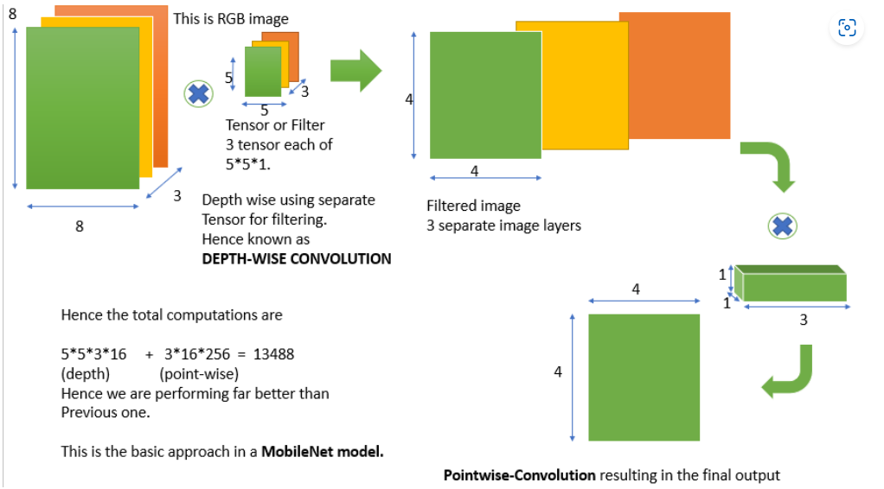
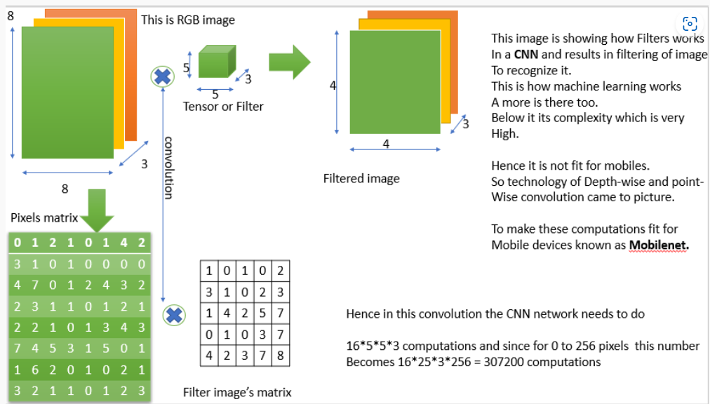
Implementation
MobileNetV2 Model
CNN Model

Slide 8
Implementation
Methodology
The proposed methodology involves a combination of image processing techniques and deep learning algorithms, particularly Convolutional Neural Networks (CNNs), to detect nutrient deficiencies in paddy crops. The following steps outline the approach.
Dataset Collection:
Gather a diverse dataset of paddy crop images representing various growth stages and nutrient deficiency scenarios. Include images with clear indications of nitrogen, phosphorus, and potassium deficiencies.
The following are the pre-processing steps for the methodology: Preprocessing, Neural Network Architecture, Model Training, Data Augmentation, Hyperparameter Tuning, Validation and Testing, Real-Time Image Analysis, Post-Processing and Reporting.

Slide 9
Implementation
Methodology
The proposed methodology involves a combination of image processing techniques and deep learning algorithms, particularly Convolutional Neural Networks (CNNs), to detect nutrient deficiencies in paddy crops. The following steps outline the approach.
Dataset Collection:
Gather a diverse dataset of paddy crop images representing various growth stages and nutrient deficiency scenarios. Include images with clear indications of nitrogen, phosphorus, and potassium deficiencies.
The following are the pre-processing steps for the methodology: Preprocessing, Neural Network Architecture, Model Training, Data Augmentation, Hyperparameter Tuning, Validation and Testing, Real-Time Image Analysis, Post-Processing and Reporting.

Slide 10
Implementation
The CNN model was trained on a diverse dataset comprising images of paddy plant leaves with known nutrient deficiencies, including Nitrogen, Phosphorous, and Potassium. The training involved preprocessing steps such as cropping, resizing, and normalization to ensure uniformity across the dataset. Data augmentation techniques, including rotation, flipping, and zooming, were applied to enhance the model's robustness.
The CNN architecture, based on MobileNetV2, was configured with multiple output nodes, each corresponding to a specific nutrient deficiency class. The model underwent extensive training and fine-tuning to minimize classification errors and improve accuracy. Hyperparameter tuning, involving experimentation with learning rate, batch size, and optimizer, was performed to optimize the CNN's performance.
The implied MobileNetV2 model obtained training and validation accuracy of 99.51% and 89.28%, respectively, with training loss of 0.014% and validation loss of 0.35%, and the testing accuracy of the MobileNet model acquired by 82%.
The suggested CNN model obtained 92.11% training accuracy and 71.88% validation accuracy, with training and validation losses of 0.22% and 0.76%, respectively. The testing accuracy of our CNN model is implied by 76%. Our accuracy is the greatest between the two models, CNN and MobileNet.

Slide 11
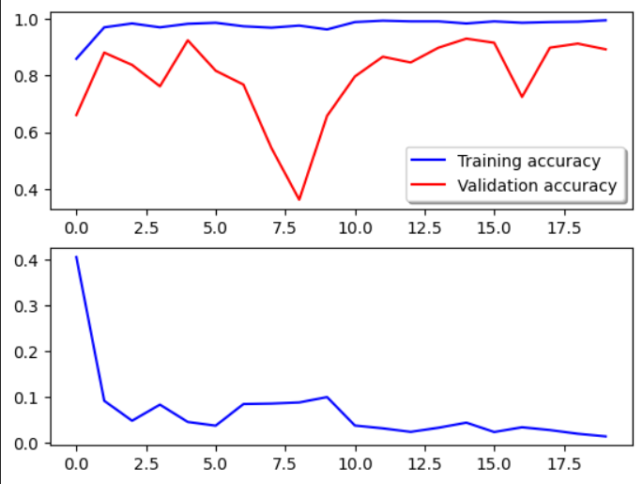
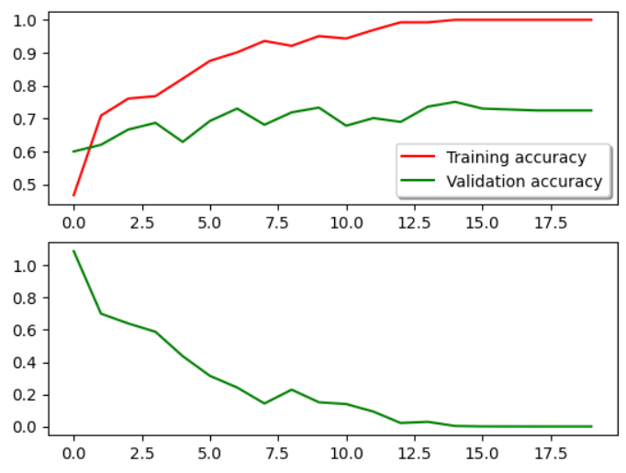
Results- Accuracy and Loss Curves
Accuracy and loss curves for MobileNet Algorithm
Accuracy and loss curves for CNN Algorithm

Slide 12
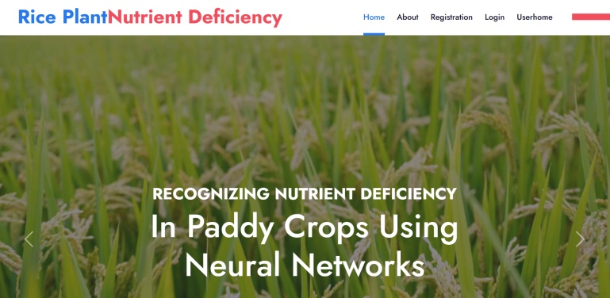

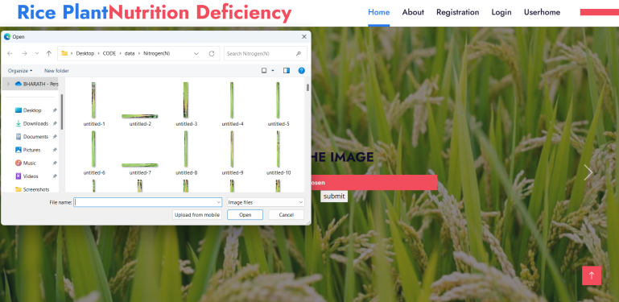


Results
User Interface
User Registration
User Login
Dataset Upload
Nutrtion Deficiency Identified by the model

Slide 13
Conclusion
In conclusion, the nutrient deficiency detection system for paddy crops has demonstrated its efficacy in providing farmers with a robust tool for early diagnosis and proactive management of nutrient imbalances. The integration of image processing techniques and convolutional neural networks (CNNs) has proven successful in accurately classifying nutrient deficiencies, offering actionable insights to farmers. The user-friendly interface ensures accessibility, while the real-time analysis and historical trend tracking empower farmers to make informed decisions about their crop management practices. The system's notification capabilities, if implemented, further enhance its responsiveness to critical deficiencies, enabling timely corrective measures. The positive results obtained during the implementation phase validate the system's potential to significantly contribute to sustainable agriculture by optimizing nutrient utilization and improving crop yields. User feedback has been instrumental in refining the system, fostering a continuous improvement cycle.

Slide 14
Future Scope
The future scope of the automated indoor gardening system includes integrating disease detection features utilizing specialized sensors and image recognition technology. Machine learning algorithms will analyze data patterns, enabling accurate disease diagnosis for timely intervention and automated responses. The system's capabilities will be enhanced through a comprehensive database and integration with external plant health resources, facilitating identification and management of various plant diseases. This expansion strengthens the system's role in plant care and contributes to building a more resilient and informed gardening community. Ourwork’s potential extends to broader applications, offering assistance in agricultural settings, ultimately benefiting farmers by streamlining tasks and reducing labour requirements.
To further enhance the nutrient deficiency detection system, several avenues for future development can be explored. Integration with advanced weather forecasting systems can provide farmers with insights into potential environmental factors affecting nutrient absorption. Additionally, incorporating machine learning techniques for adaptive learning from user feedback can enhance the system's predictive capabilities over time.
The inclusion of a mobile application would extend accessibility, allowing farmers to capture and upload real time images directly from the field. Implementing a recommendation engine based on regional soil conditions and crop varieties would provide more tailored corrective measures.
Furthermore, collaborative features, such as farmer forums and knowledge-sharing platforms, can be integrated to facilitate community-driven insights and best practices. Continuous research into emerging technologies, such as hyperspectral imaging, could open new possibilities for even more accurate nutrient deficiency detection.

Slide 15
Thank You!!!

